Slide 1


DECODE GAMING BEHAVIOR
Gaming analysis with sql
Internship Project By Pooja Upadhye with Mentorness
BATCH NAME- MIP-DA-06

Slide 2

CONTENT
About the Project
Dataset Description
Import the data
Analysis SQL problems statement
What I learn

Slide 3

ABOUT THE PROJECT
In this internship i was working with Dataset related to Game Analysis. The Dataset includes two tables
PLAYER DETAILS TABLE
P_ID: Player ID
PName: Player Name
L1_status: Level 1 status
L2_status: Level 2 status
L1_code: system generated Level 1 code
L2_code: System generated Level 2 code
LEVEL DETAILS TABLE
P_ID :Player ID
Dev_ID: Device ID
start_time: start time
stages_crossed: Stages Crossed
level: Game level
difficulty :Difficulty Level
kill_count: kill count
headshots_count :Headshots Count
score: Player Score
lives_earned: Extra lives Earned
04

Slide 4
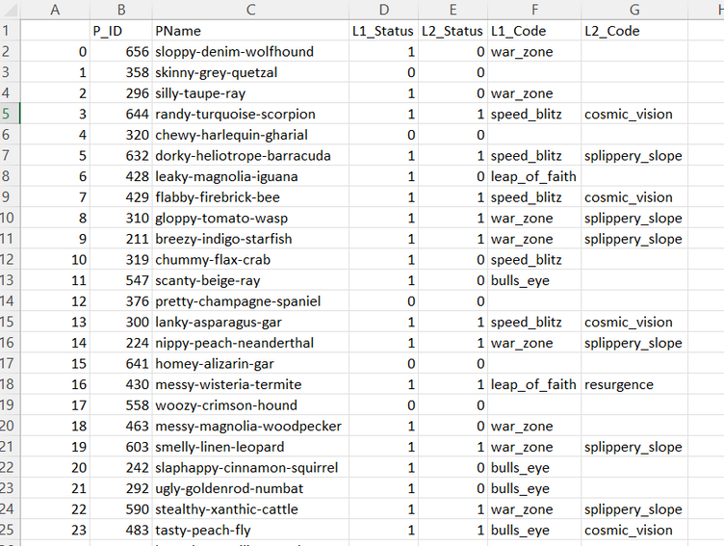
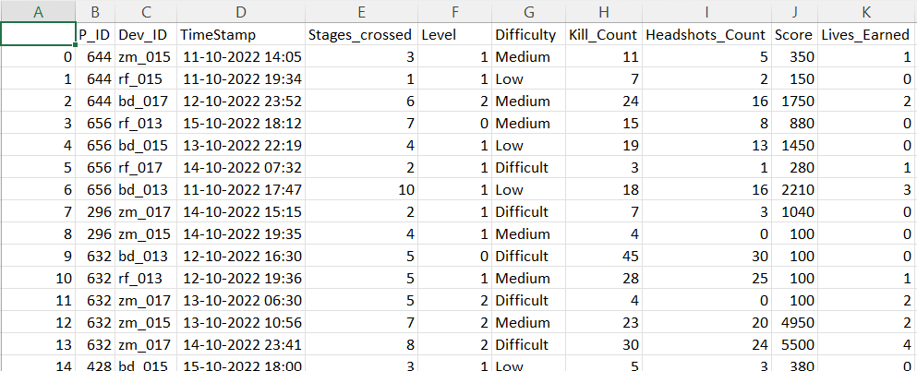
OVERVIEW OF DATASET
Player_detail Table:
Level_detail Table

Slide 5

DATASET DESCRIPTION
1) Players play a game divided into 3-levels (L0,L1 and L2)
2) Each level has 3 difficulty levels (Low, Medium, High)
3) At each level, players have to kill the opponents using guns/physical fight
4) Each level has multiple stages at each difficulty level.
5) A player can only play L1 using its system generated L1_code.
6) Only players who have played Level1 can possibly play Level2
using its system generated L2_code.
7) By default a player can play L0.
8) Each player can login to the game using a Dev_ID.
9) Players can earn extra lives at each stage in a level.

Slide 6
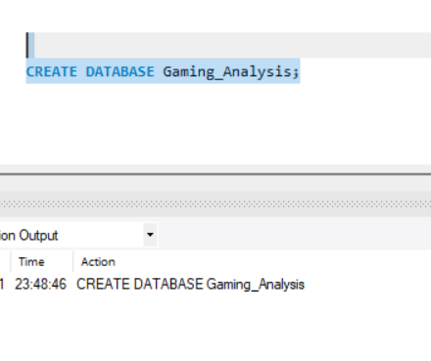
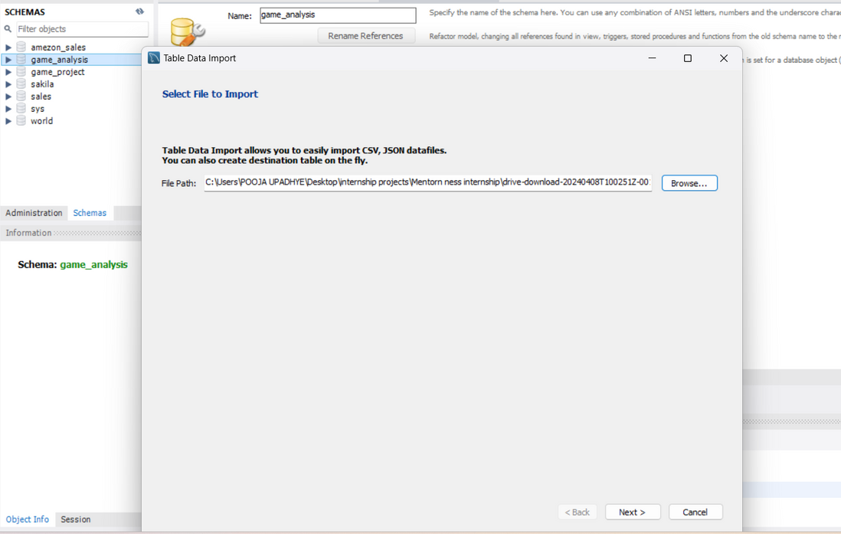
IMPORT THE DATA
Your paragraph text
Browse file to import data:
Create Database:
04

Slide 7
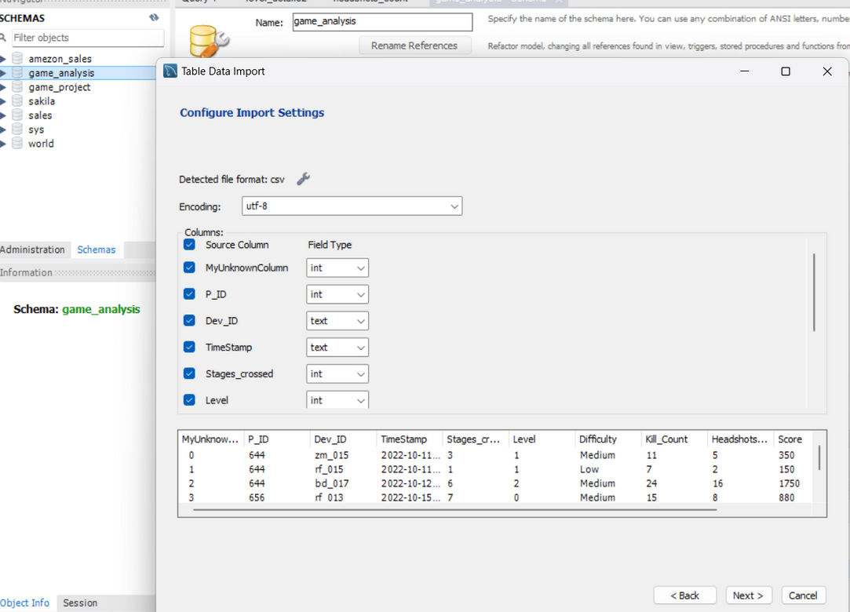
IMPORT THE DATA
Configure Import Settings
03

Slide 8
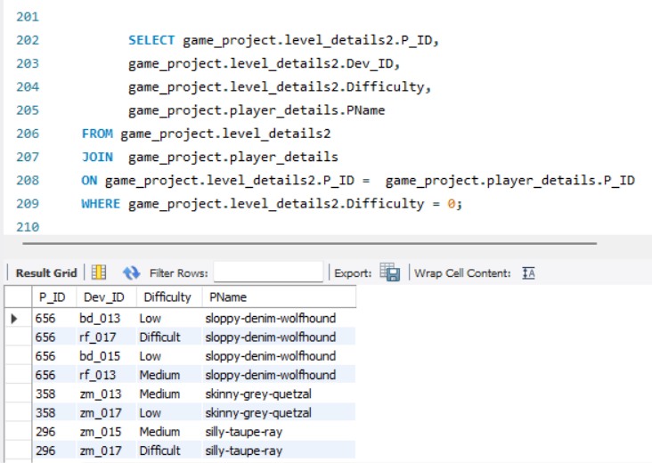
ANALYSIS SQL PROBLEM STATEMENT
Q1) Extract P_ID, Dev_ID, PName and Difficulty_level of all players at level 0

Slide 9
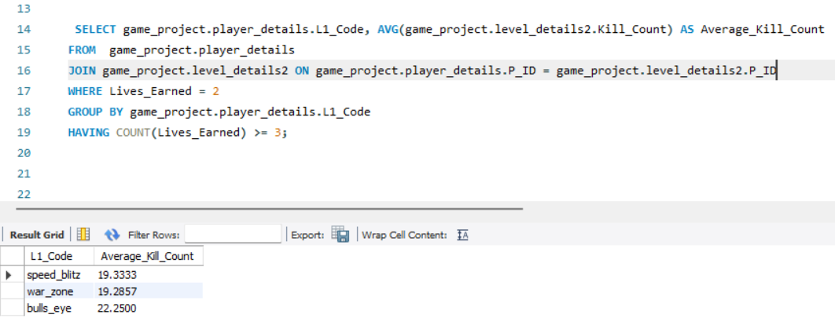
ANALYSIS SQL PROBLEM STATEMENT
Q2) Find Level1_code wise Avg_Kill_Count where lives_earned is 2 and atleast 3 stages are crossed.

Slide 10
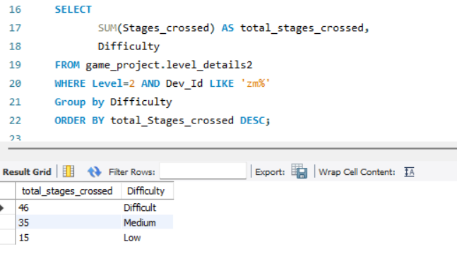
ANALYSIS SQL PROBLEM STATEMENT
Q3) Find the total number of stages crossed at each difficulty level where for Level2 with players use zm_series devices. Arrange the result in decsreasing order of total number of stages crossed.

Slide 11
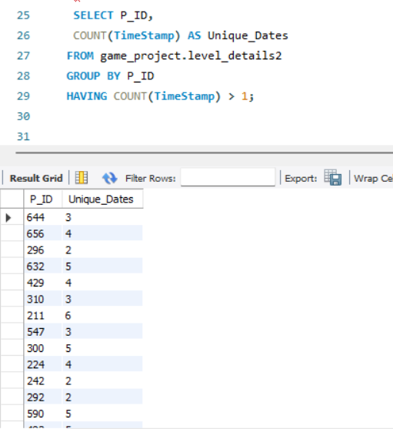
ANALYSIS SQL PROBLEM STATEMENT
Q4) Extract P_ID and the total number of unique dates for those players who have played games on multiple days.

Slide 12
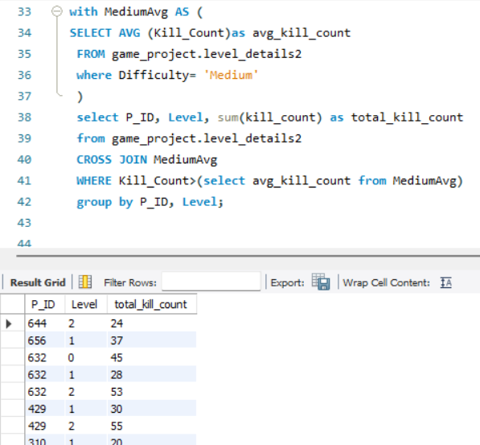
ANALYSIS SQL PROBLEM STATEMENT
Q5) Find P_ID and level wise sum of kill_counts where kill_count is greater than avg kill count for the Medium difficulty.
03

Slide 13
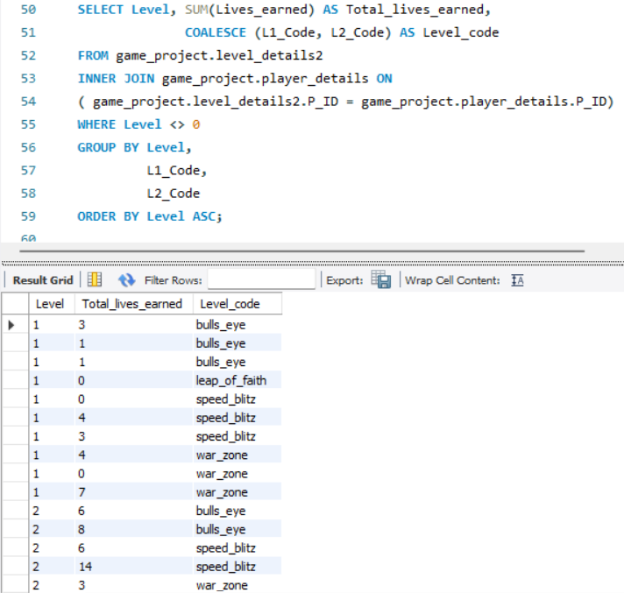
ANALYSIS SQL PROBLEM STATEMENT
Q6) Find Level and its corresponding Level code wise sum of lives earned excluding level 0. Arrange in asecending order of level.

Slide 14
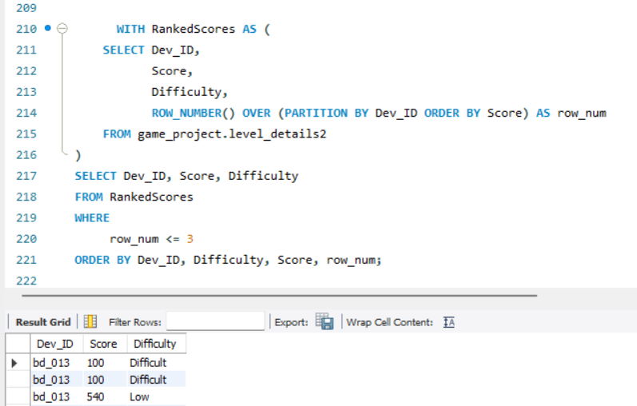
ANALYSIS SQL PROBLEM STATEMENT
Q7) Find Top 3 score based on each dev_id and Rank them in increasing order using Row_Number. Display difficulty as well.

Slide 15
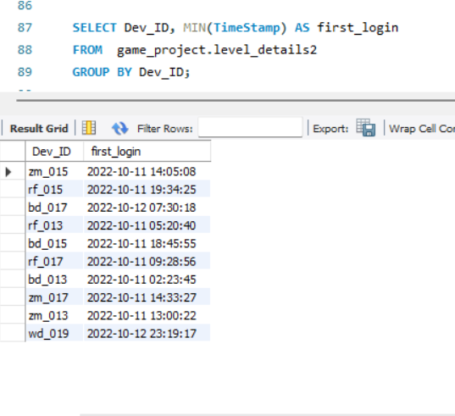
ANALYSIS SQL PROBLEM STATEMENT
Q8) Find first_login datetime for each device id

Slide 16
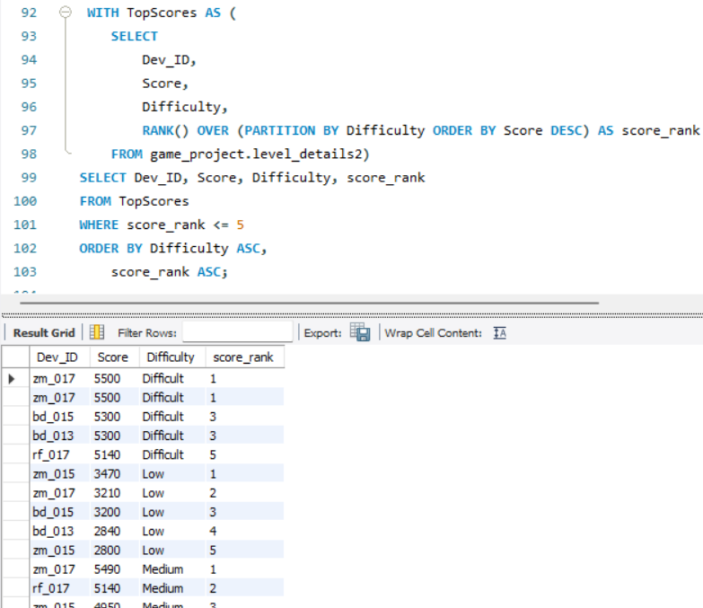
ANALYSIS SQL PROBLEM STATEMENT
Q9) Find Top 5 score based on each difficulty level and Rank them in increasing order using Rank. Display dev_id as well.

Slide 17
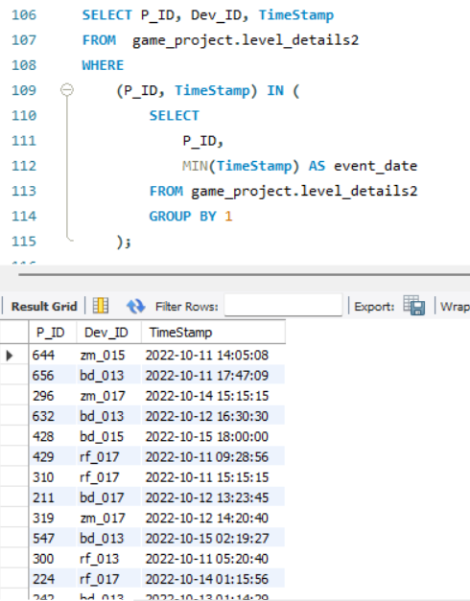
ANALYSIS SQL PROBLEM STATEMENT
Q10) Find the device ID that is first logged in(based on start_datetime) for each player(p_id). Output should contain player id, device id and first login datetime.

Slide 18
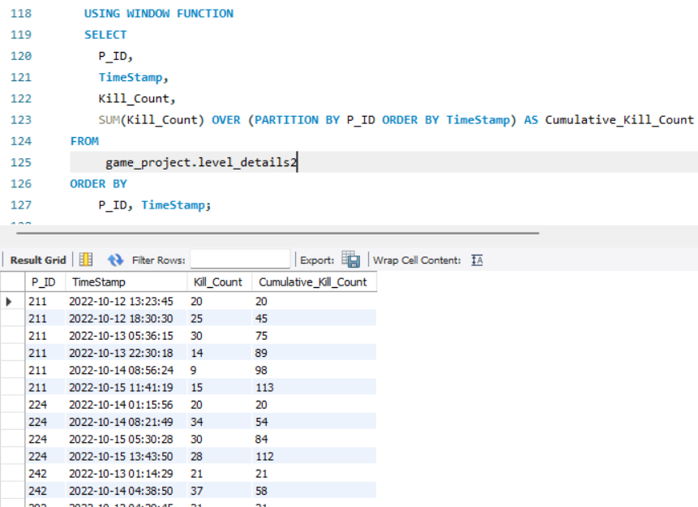
ANALYSIS SQL PROBLEM STATEMENT
Q11) For each player and date, how many kill_count played so far by the player. That is the total number of games played by the player until that date.
a) window function

Slide 19
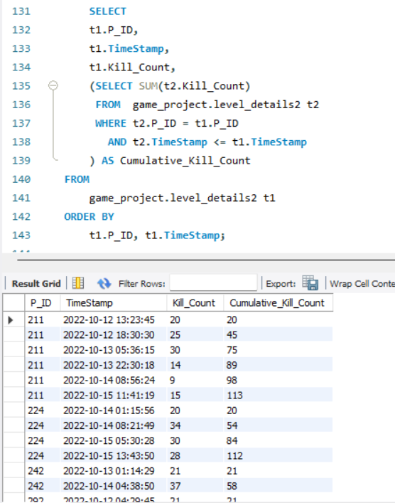
ANALYSIS SQL PROBLEM STATEMENT
Q11) For each player and date, how many kill_count played so far by the player. That is the total number of games played by the player until that date.
b) without window function

Slide 20
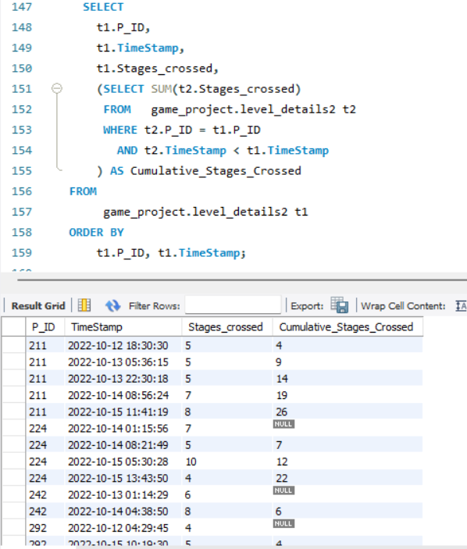
ANALYSIS SQL PROBLEM STATEMENT
Q12) Find the cumulative sum of an stages crossed over a start_datetime for each player id but exclude the most recent start_datetime

Slide 21
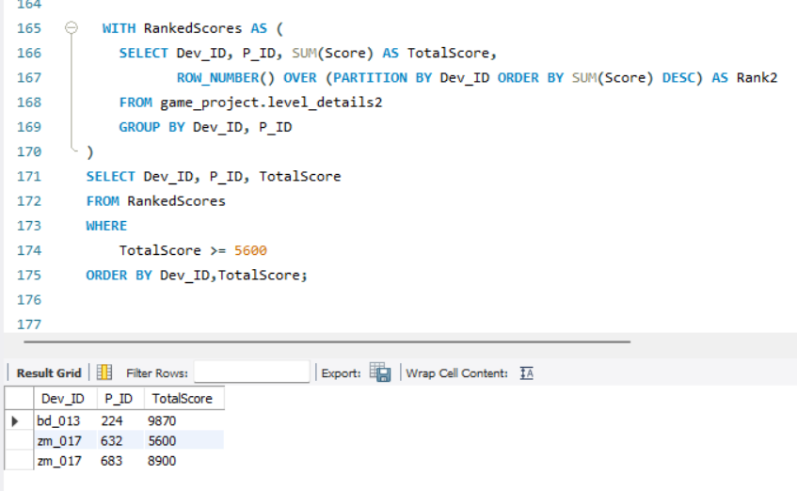
ANALYSIS SQL PROBLEM STATEMENT
Q13) Extract top 3 highest sum of score for each device id and the corresponding player_id

Slide 22
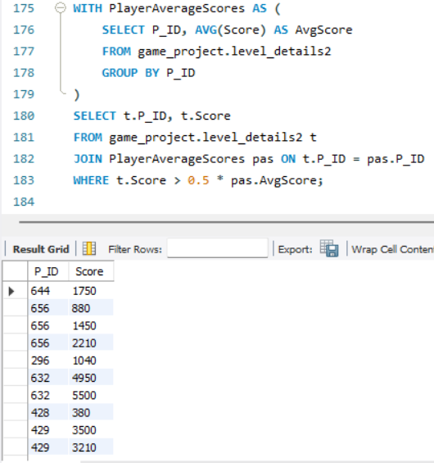
ANALYSIS SQL PROBLEM STATEMENT
Q14) Find players who scored more than 50% of the avg score scored by sum of scores for each player_id

Slide 23
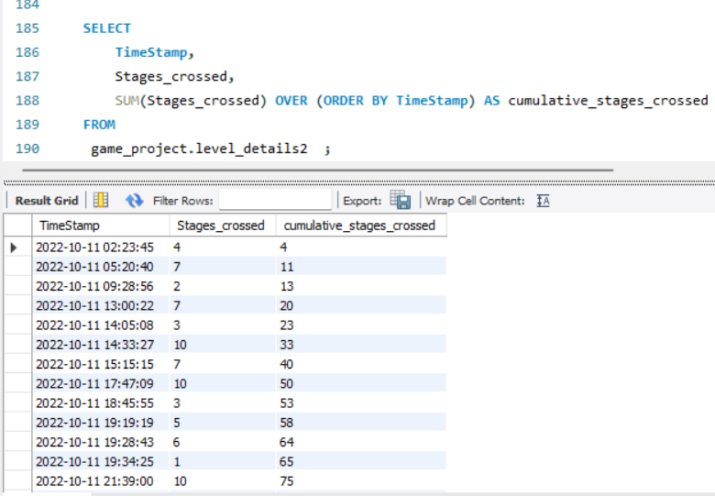
ANALYSIS SQL PROBLEM STATEMENT
Q15) Find the cumulative sum of stages crossed over a start_datetime .

Slide 24
WHAT I LEARN
SQL JOINS
SQL GROUP BY and HAVING Clause
ROW NUMBER and RANK Function
Minimum and Top Function

Slide 25
THANK YOU

